Slide 1
QuickShop
Phillip Schoen

Slide 2

What it is
Android application to make shopping more efficient
Most efficient path through grocery store based on user shopping list

Slide 3
Purpose
Overall make shopping more efficient
Get through grocery store quicker
Find items faster
Stick to shopping list
Limit impulse buys
Spend less money

Slide 4
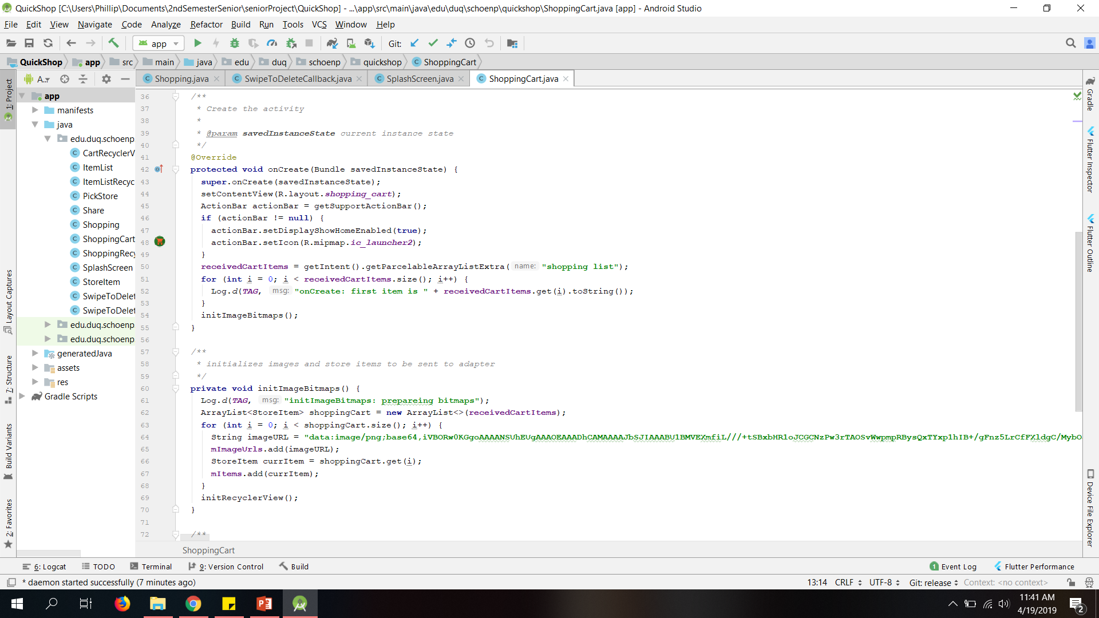
How I did it
Research
Android Studio
Emulator
Java
Activities
Intents
Extras
Recycler Views/adapters
Broadcast Receivers
Callbacks
List optimization

Slide 5
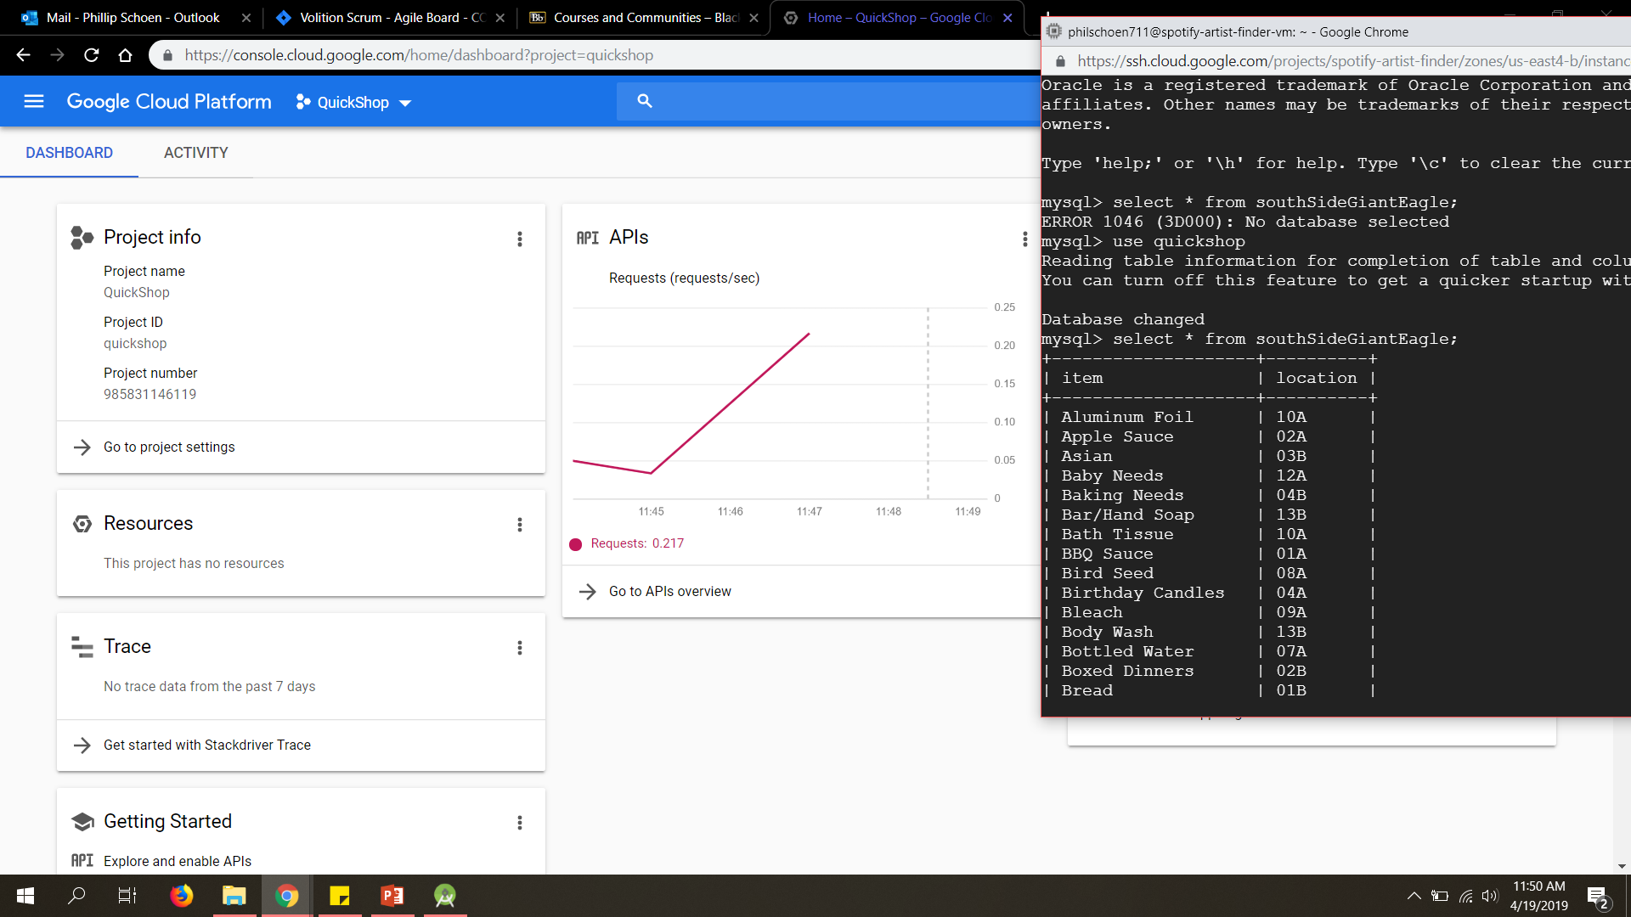
How I did it cont…
XML
Layout
Google Cloud Platform
MySQL database
PHP Script
Google Maps API
API Keys
Icon Generator

Slide 6
Demonstration

Slide 7
Outcome and improvements
Fully working app
Source code, Documentation, Installation instructions
https://github.com/schoenp711/QuickShop/
More stores
Custom Items
Custom Images for items
Better design
More thorough algorithm
Fit more store designs

Slide 8
By the numbers
146 store items
2558 lines of code
73 days
10.18 MB

Slide 9
Special Thanks
Dr. Simon
Duquesne University Math and Computer Science Department
Peers
My mom

